Slide 1
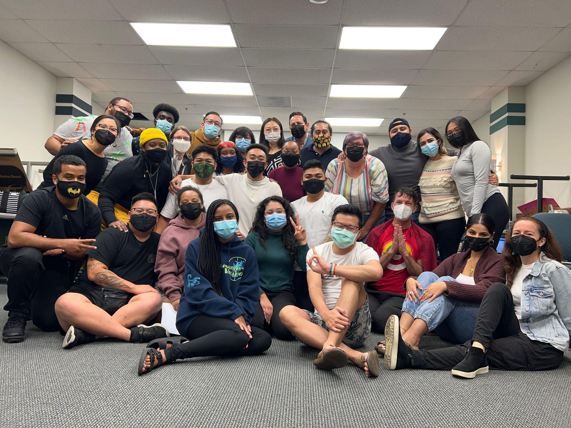
INFORMATION SESSION
MULTICULTURAL COMMUNITY COUNSELING AND SOCIAL JUSTICE EDUCATION
Licensed Professional Clinical Counseling
Department of Counseling & School Psychology
College of Education
CBB 2020-21
2021
Notes:
Open House:
Nola will introduce herself and provide a short welcome message and overview of the Info session, and intro administrators, if they come.
-Faculty will introduce themselves
-Students
-Interested applicants

Slide 2
Graduate Assistant
Terry Sivers, MS, Doctoral Student--SDSU/Claremont Joint Doctoral Program in Education
cbbgradasst@sdsu.edu
Notes:
Nola

Slide 3
Core Faculty
Nola Butler Byrd, Ph.D., LPCC
Assoc. Professor, CBB Program Director
Nellie Tran, Ph.D.
Associate Professor, Community Psychologist
Arianne Miller, Ph.D.
Assistant Professor & Licensed Clinical Psychologist
Juan Camarena, Ph.D., LMFT, LPCC
Full-Time Lecturer
Notes:
Nola

Slide 4
Graduate Assistant
Nola Butler Byrd, Ph.D., LPCC
Assoc. Professor, CBB Program Director
Nellie Tran, Ph.D.
Associate Professor, Community Psychologist
Arianne Miller, Ph.D.
Assistant Professor & Licensed Clinical Psychologist
Juan Camarena, Ph.D., LMFT, LPCC
Full-Time Lecturer
Notes:
Nola

Slide 5
Part-Time Faculty
Celena Martinez, M.S., LPCC
Leticia Gonzalez Pileski, PsyD., LMFT
Michelle Rowe-Odom
Jermaine Simpson, MS, LMFT
Tuan To, PsyD
Natividad Cabrera, MS, APCC
Halima Eid, APCC
Andrea Gottschalk, MS, LPCC
Antara Kobayshi, LMFT
Nicole Jones, MS
Michelle Lara, APCC
Notes:
Nola

Slide 6
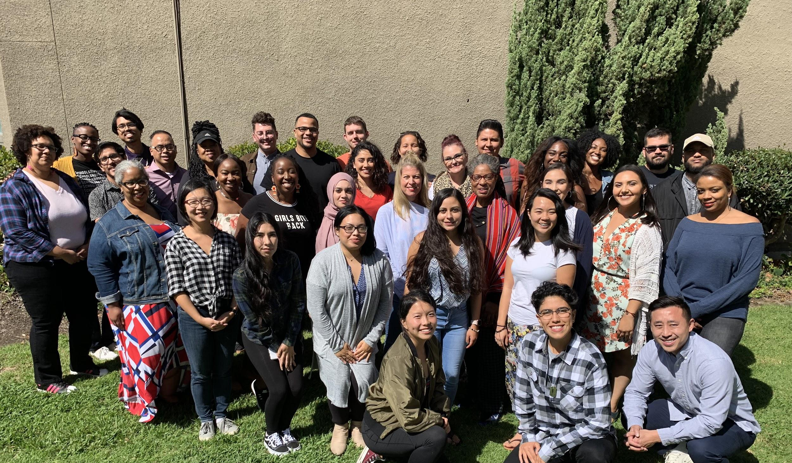
CBB4Life Alumni Association
CBB 2019-20
Notes:
Maria

Slide 7
What is CBB?
A two-year professional counselor preparation program that meets all of the requirements for the Master of Science in Counseling with a concentration in Multicultural Community Counseling.
Designed to provide learners with the education and experience necessary to prepare for LPCC licensure, as well as doctoral studies in counseling and education.
Also intended for persons who want to increase their understanding of human behavior, multicultural issues and interpersonal skills—especially those working or planning to work in counseling positions that may not require specific licensure or state credentials.
Many CBB graduates have also used this degree to qualify for student services positions in community colleges and universities.
Notes:
Nola

Slide 8
Vision
VISION: To enhance quality of life for underserved individuals and communities, CBB facilitates positive social change through culturally responsive community mental health education, service, scholarship, and advocacy.
Notes:
Nola

Slide 9
Mission
Guided by principles of social justice and community building, CBB prepares diverse, underserved students to become culturally responsive counselor/change agents and leaders.
Notes:
Nola

Slide 10
CBB1 (2013-16) & CBB2 (2014-16)
Notes:
Maria

Slide 11
History
Founded in 1973 by Dr. Dave Malcolm
Dr. Maria Nieto Senour – 38 years of service, including program director for many years.
Partners-in-Learning Community Pedagogy
Each One, Teach One
Si Se Puede—Yes, we Can!
Notes:
Nola—history overview
CBB prepared unlicensed counselors for over 40 years that serve schools, communities, colleges and universities.
Dave Malcolm’s partners-in-learning philosophy and pedagogy continues to serve as a critical consciousness and inspiration for the CBB Program and corresponds to Freire’s definition of critical pedagogy:
…pedagogy of the oppressed, a pedagogy which must be forged with, not for, the oppressed (whether individuals or peoples) in the incessant struggle to regain their humanity. This pedagogy makes oppression and its causes objects of reflection by the oppressed, and from that reflection will come their necessary engagement in the struggle for liberation. And in the struggle this pedagogy will be made and remade. (Freire, 1972, p. 30)
Each One Teach One (EOTO) is an African American proverb about a teaching and mentoring practice and Si Se Puede, the rallying cry of the United Farm workers. The legacies of Each One Teach One and Si Se Puede philosophies that promote academic and social support and achievement that aid in breaking down the blockages and barriers that scholars from disadvantaged backgrounds continue to face, including instilling a sense of connection and belonging in academic spaces that empower disadvantaged students to find their voices and own their learning processes.

Slide 12
PARTNERS-IN-LEARNING COMMUNITY
PHILOSOPHY & PEDAGOGY
CSP 650 Trauma in Multicultural Contexts
Fall 2015
Wednesdays—CBB at Beckwourth Public Library, Southeast San Diego
Notes:
Arianne - The foundation of CBB’s Learning community is our commitment to forming a partnership-in-learning between students and faculty. CBB works with a basic assumption that students bring valuable experience and knowledge to the program that informs what the community will learn and how we will learn it. Often this means, students will work with faculty to develop syllabi, activities and assignments for each of their courses.

Slide 13
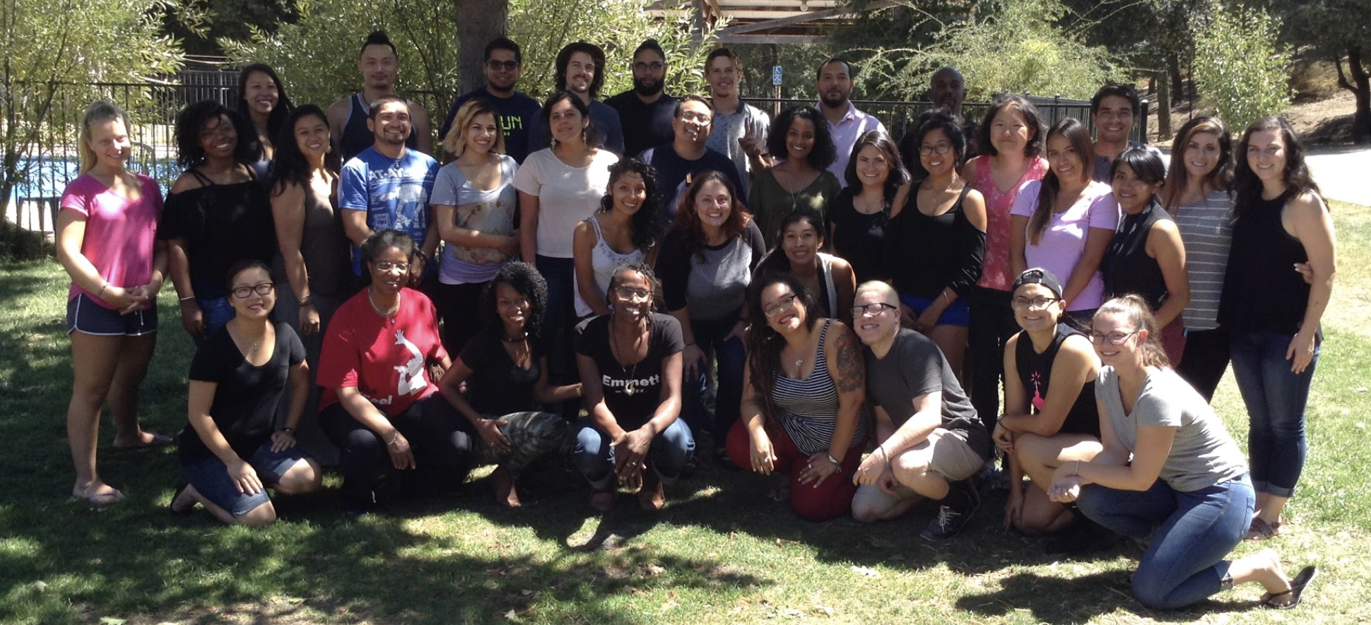
CBB Learning Communities
MULTICULTURAL COMMUNITY COUNSELING AND SOCIAL JUSTICE EDUCATION
Licensed Professional Clinical Counseling
Department of Counseling & School Psychology
College of Education
CBB 2016-18
Notes:
AriannAe”

Slide 14
CBB Learning Communities:
Critical Theory
Democratic Processes
Affective Experiential Learning Strategies
Multicultural Education
Community Capital
Build a multicultural learning community composed of highly diverse individuals—many from disadvantaged backgrounds.
Develop a healthy learning environment for all of its members, where faculty and students work as partners in the learning process.
Collaboratively develop syllabi that emerge from community needs and the tasks the community sets out to perform in the communities we serve and at field sites, including the community counseling clinic.
Notes:
Nellie
Inspired by Dr. Dave Malcolm’s original vision, but modified to address current community needs for licensed professional counselors.
Build a multicultural learning community composed of highly diverse individuals—many from disadvantaged backgrounds, who are committed to working with and through community to learn the skills, knowledge and abilities needed to become social justice advocates and address injustice, including educational and economic inequality.
Develop highly competent, licensed multicultural community counselors who will serve the needs of diverse individuals and communities suffering mental and emotional distress and trauma, while developing love, well-being, good self-care and healthy relationships.
Develop a healthy learning environment for all of its members, where faculty and students work as partners in the learning process.
Collaboratively develop syllabi that emerge from community needs and the tasks the community sets out to perform in the communities we serve and at field sites, including the community counseling clinic.

Slide 15
CBB Learning Communities (Cont’d)
The Power of Community:
-Learning
-Healing
-Well-being
-Social Justice
In this context, students learn:
counseling and community-building skills,
critical self-awareness,
awareness of one’s effects on others
empathy
emotional stamina and resilience
Create an environment very similar to what communities face—one that is filled with ambiguity, disequilibrium, tension, and conflict—but also love, compassion, appreciation, support and empathic alliances.
Notes:
Nellie

Slide 16
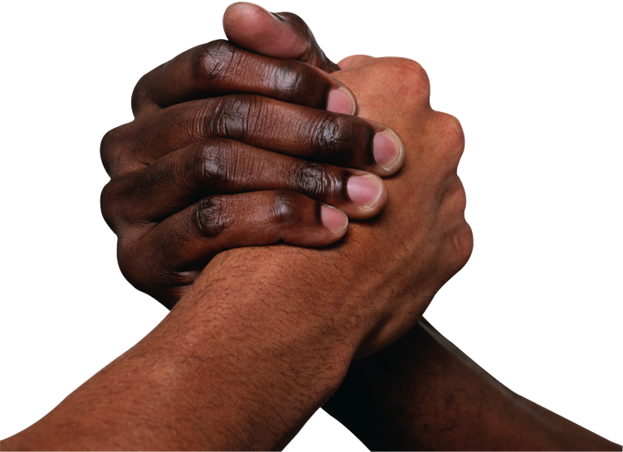
Community
Sense of belonging is recognized as an important determinant of psychological and physical well-being.
Connection
Community Capital
Notes:
Nellie
Yosso, T.J. (2005). Whose culture has capital? A critical race theory discussion of community cultural wealth. Race Ethnicity and Education, 8(1), pps. 69-91. http://citeseerx.ist.psu.edu/viewdoc/download?doi=10.1.1.500.5873&rep=rep1&type=pdf
Aspirational Capital—the ability to maintain hopes and dreams for the future, even in the face of real and perceived barriers.
Linguistic capital—includes intellectual and social skills attained through communication experiences in more than one language and/or style. Students of Color with multiple languages and communication skills, including storytelling traditions
Familial capital—cultural knowledge's nurtured among kin that carry a sense of community history, memory and cultural intuition. Engages a commitment to community well being and expands the concept of family. Love and well-being
Social Capital—networks of people and community resources that can provide both instrumental and emotional support to navigate through societies' institutions.
Navigational capital refers to skills of maneuvering through social institutions.
Resistant capital refers to knowledge's and skills fostered through oppositional behavior that challenges inequity.

Slide 17
Critical Role of Community in Mental Health & Well-Being
Traditional counseling models train practitioners to work one-on-one with people with the idea that the individual is the locus of the problem. In CBB, we work instead within a whole social context, with a whole community, and support counselors in becoming sources of support for each other, individuals and communities.
Community interventions play an important role in successful mental health treatment
Social Isolation = mental illness
People need to learn to work together in community in order to thrive and survive.
In cross-cultural community, people learn relational and life skills that many have never learned and participate in a social ritual.
Notes:
Juan

Slide 18
CBB Learning Environment
Emotional Intensity & Management
CBB is a very intense program emotionally, physically, spiritually and academically. It is also time and labor intensive.
The program is designed to foster intra-psychic development for each student. This growth is triggered by the emphasis placed on self-awareness, relationships and personal growth.
It is also the result of the mental and emotional impact of the extremely sensitive subject matter (i.e. racism, sexism, homophobia, class bias and various other oppressions) with which CBB deals.
Students often find themselves questioning their fundamental values and perspectives, which is a very uncomfortable, challenging process.
Notes:
Juan

Slide 19
CBB STRENGTHS AND CHALLENGES
Monday Practica, Fall 2015 CCCE Clinic Orientation - Dede Alpert Center for Community Engagement - City Heights
CBB1 (2013-16) & CBB2 (2014-16)
Notes:
AA

Slide 20
2014-16 CBB Program Transformation
From 30-unit MA in Education with a concentration in Counseling
To 60⁺ unit MS in Counseling with a concentration in Multicultural Community Counseling.
Notes:
Arianne

Slide 21
Why CBB-LPCC?—Increase Diverse Counselors
Inequality continues to grow in US society and is increasing societal ills, including mental health issues.
SoCAL is one of the most diverse areas in the U.S.
Over 2 million Californians are affected by mental & emotional illness annually.
Untreated mental illness is leading cause of disability and suicide & imposes high costs on communities.
Notes:
Arianne
According to the United States Department of Labor Bureau of Labor Statistics (2014) there are approximately just over 11, 000 employed mental health counselors in just California alone and few identify as counselors of color. In fact, over 70% of working counselors in the U.S. identify as white/Euro-American (U.S. Bureau of Labor Statistics, 2013).

Slide 22
Why CBB-LPCC?—Increase Diverse Counselors
High vacancy rate for culturally competent community-based counselors.
Under 30% of counselors are ethnically or culturally diverse or come from the marginalized communities they serve.
Notes:
Arianne - we want to help fill this gap!

Slide 23
Center for Community Counseling & Engagement--Reception
CBB Fall 2015
Notes:
Nola

Slide 24
LPCC, LPC or LMHC—National Perspective www.calpcc.org
Known by different titles: Licensed Professional Clinical Counselors, Licensed Professional Counselors or Licensed Mental Health Counselors
Masters degree mental health service providers, trained to work with individuals, families and groups in treating mental, behavioral and emotional problems.
LPCCs make up a large percentage of the workforce employed in community mental health centers, agencies and organization, and are employed and covered by managed care organizations and health plans.
Also work with active duty military personnel and their families, as well as veterans.
Notes:
Nola

Slide 25
California 50th State to License 4 Mental Health Professions—2013 ACA Statistics www.calpcc.org
Licensed Professional Counselors (aka LPCs, LCPCs, LCMHCs)
144,000 nationwide (1,200 in CA)
Licensed Marriage & Family Therapists (LMFTs)
58,000 nationwide (37,000 in CA)
Licensed Clinical Social Workers (LCSWs)
225,000 nationwide (22,000 in CA)
Licensed Psychologists
154,000 nationwide (18,000 in CA)
Notes:
Nola
2002-04 -- 12 professional associations joined forces and raised funds, drafted legislation, worked with stakeholders, regulars, engaged lobbyists.
2005-09 Three bills went to the legislature. SB 788 was signed by the Governor in 2009
2010 SB788 became law in January
The BBS considers LPCCs to be on par with LMFTs and LCSWs
The requirements for the California LPCC are on par, or exceed the requirements for LPCs in other states.

Slide 26
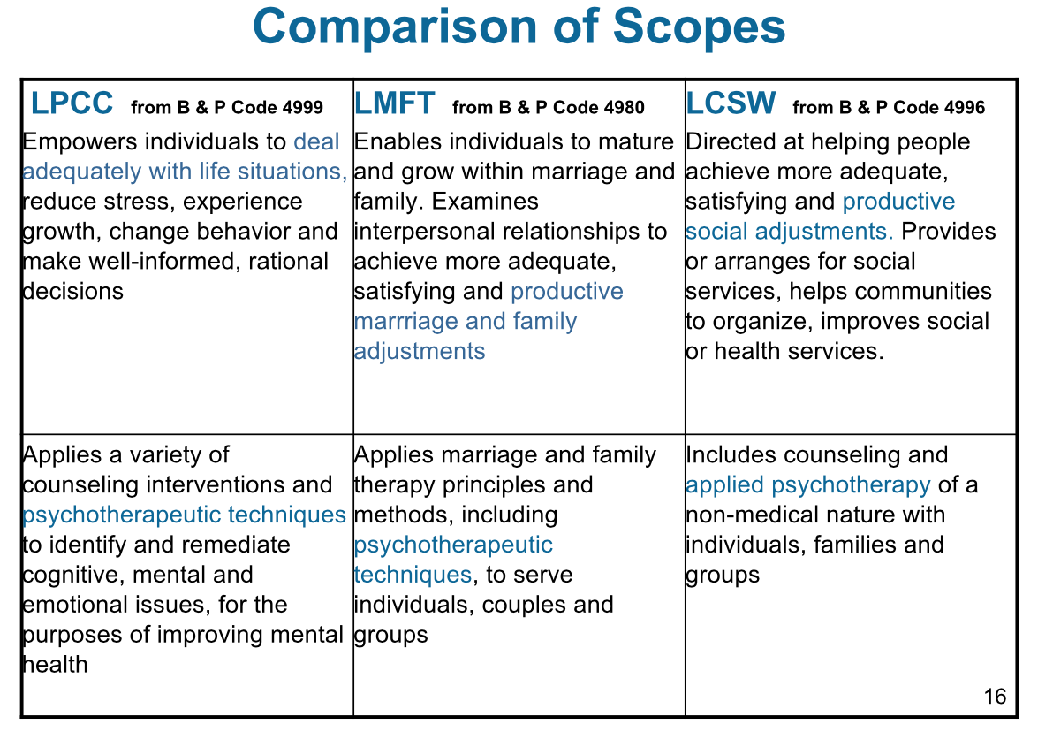
Notes:
Nola -- or Juan

Slide 27
What LPCC’s Can Do www.calpcc.org
LPCCs are a large percentage of the U.S. mental health workforce.
Work in Mental health centers, agencies & organizations.
Work with individuals, families and groups.
Treat mental, behavioral and emotional problems.
Are covered by managed care organizations and health plans.
Work with military personnel, veterans and their families (DoDs, TRICARE, VA).
Can treat couples and families without previous additional requirements. Effective January 1, 2022--AB 462 Licensed Professional Clinical Counselors (LPCCs): Elimination of Additional Requirements to Assess or Treat Couples and Families and Elimination of Requirement for 150 Hours of Clinical Experience in a Hospital or Community Mental Health Setting
Notes:
Juan
By the end of 2015:
LPCCs/PCCIs who want to treat couples and families can submit documentation of MFT coursework and supervised hours to the BBS
BBS will provide written confirmation that MFT requirements are met.
LPCCs will provide this confirmation to clients and supervisees (pending BBS regulation 1820.5 – 7)
Scope of Practice—B&P Code 4999.20 (www.calpcc.org)
Application of counseling interventions and psychotherapeutic techniques to improve mental health.
Identification and remediation of cognitive, mental and emotional issues, including personal growth, adjustment to disability and crisis intervention.
Empowering individuals to deal adequately with life situations, reduce stress, experience growth, change behavior, and make well-informed decisions.

Slide 28
What the Scope Does Not Include? —B&P Code 4999.20 (www.calpcc.org)
Projective techniques in the assessment of personality.
Individually administered IQ tests.
Neuropsychological testing.
Utilization of a battery of three (3) or more tests to determine presence of psychosis, dementia, amnesia, cognitive impairment or criminal behavior.
Notes:
Juan

Slide 29
LPCC Updates www.calpcc.org
February 2012: the first LPCC licenses were issued; by 2015 1,215 LPCCs are licensed; 948 PCCIs, registered.
February 2014: DHCS announced that LPCCs are qualified providers of Medi-Cal speciality mental health services.
2015:
50% of CA’s 65 counties have updated their job descriptions to include PCCIs and LPCCs.
Most private insurance companies are reimbursing LPCCs.
Effective January 1, 2022--AB 462 Licensed Professional Clinical Counselors (LPCCs): Elimination of Additional Requirements to Assess or Treat Couples and Families and Elimination of Requirement for 150 Hours of Clinical Experience in a Hospital or Community Mental Health Setting
Notes:
Nola

Slide 30
2012 LPCC Education Requirements www.bbs.ca.gov
A BBS qualified 60+ unit degree.
Must include service delivery in recovery-oriented practice environments.
Integrate an understanding of various cultures and the social and psychological implications of socioeconomic position.
Include 13 core areas, including 3 units of advanced counseling and psychotherapeutic theories & techniques.
Notes:
Nola

Slide 31
LPCC Core Content Areas www.calpcc.org
Counseling & psychotherapy
Human growth & development
Career Development
Group Counseling
Assessment
Multicultural counseling
Diagnostic process
Research and evaluation
Professional orientation (Law & Ethics)
Psychopharmacology
Substance Abuse/Addictions Counseling
Crisis/Trauma Counseling
Notes:
Arianne

Slide 32
Live Supervision of Culturally Diverse, Bilingual Practica, Community-Based Fieldwork and Internships
Included within the course requirements are the clinical experiences of practicum, fieldwork and internship.
Students must complete a minimum of 280 hours of face-to-face supervised clinical experience counseling individuals, families, or groups.
CBB Practicum supervisors provide live supervision of student-client interactions during counseling sessions at the Center for Community Counseling Clinic using one-way mirrored counseling booths and an intercom system.
CBB students receive an average of at least one hour of direct supervisor contact for every five hours of client contact in each setting. “One hour of direct supervisor contact,” means one hour of face-to-face contact on an individual basis, or two hours of face-to-face contact in a group of not more than eight persons in segments lasting no less than one continuous hour.
Notes:
Arianne

Slide 33
LEARNING GOALS AND OBJECTIVES
Center for Community Counseling and Engagement
Notes:
Nellie

Slide 34
Core Learning Objectives
COMMUNITY COUNSELING KNOWLEDGE & SKILLS
Awareness and knowledge of counseling theories, models and methods from a multicultural perspective and a transformative paradigm and apply them in counseling practice and research
MULTICULTURAL/
MULTILINGUAL
conceptualize and integrate multicultural knowledge and experience into community counseling theory, practice and research
CBB
Multicultural Community Counselor/Advocates
SOCIAL JUSTICE & ADVOCACY
conceptualize and integrate social justice and advocacy into counseling theory, practice and research
Democratic theory, processes & skills; critical theory, community capital.
SELF-AWARENESS & CARE
conceptualize and practice self- awareness and personal insight that supports professional growth and development in the interest of clients and communities.
Notes:
To help meet the counseling needs of the growing populations of diverse, disadvantaged groups by training students from these populations.
To develop foundational cross-cultural knowledge, awareness and advocacy for each student in the program.
To develop counseling interventions and methodologies which are culture/life appropriate for the needs of the various under-represented populations needing to be served.
To develop integrative counseling knowledge and skills that use critical analyses and culturally adaptive insights for existing counseling theories as they apply to non-mainstream populations and the integration of complementary healing methods.
To become an informed consumer of research and to use research methods that are sensitive and appropriate for multicultural contexts.
To develop counselors who are committed to work on their own personal issues that could interfere in their work with clients, both in the program and outside the program by seeking counseling from a trained therapist.

Slide 35
Sample CBB Sequence of Study—Year #1
Fall
Spring
CSP 740 Practicum: Individual Counseling
CSP 730 Fieldwork in Counseling
CSP 600/L Cross-Cultural Counseling & Lab
CSP 606B Professional Issues in Mental Health Practice: Community-Based Block
CSP 621/L Social Justice Democratic Theory, Processes, and Skills & Lab
CSP 650 Trauma and Crisis Counseling in Multicultural Contexts
CSP 740 Practicum: Individual Counseling
CSP 730 Fieldwork in Counseling
ED 690 Methods of Investigation & Inquiry
CSP 601 Theoretical Foundations of Counseling and Marriage and Family Therapy
CSP 618 Contexts of Psychopathology
CSP 615 Cross-Cultural Counseling Communication Skills
Notes:
Nellie

Slide 36
Sample CBB Sequence of Study—Year #2
Fall
Spring
CSP 780 Internship in Counseling
CSP610C Determinants of Human Behavior: Development (including Aging)
CSP 642/L Culturally Competent Assessment in Multicultural Contexts
CSP 680 Theory and Process of Consultation: Multicultural Community Engagement for Effective Practice
CSP 670/L Theory and Process of Group Counseling
CSP 687 Family and Systemic Treatment of Substance Abuse
CSP 780 Internship in Counseling
CSP 710A Professional Seminar Clinical Community Capstone
CSP 694 Psychopharmacology
CSP 635 Sexuality and Intimacy in Couple and Family Therapy and Counseling
CSP 691 Violence in Couples Relationships
CSP 688 Family Systems Assessment of Child Abuse
CSP 645 Career Counseling
Notes:
Nellie

Slide 37
CBB LPCC “TRACKS”
CLINICAL MENTAL HEALTH COUNSELING
Serve community clinics or private practice
COLLEGE COUNSELING
Serve community colleges and universities
K-12 COUNSELING
Serve K-12 schools
Pilot - Doctoral Studies
SDSU/Claremont Joint Doctoral Program
CBB Concurrent Enrollment
Year #2
Notes:
Nola

Slide 38
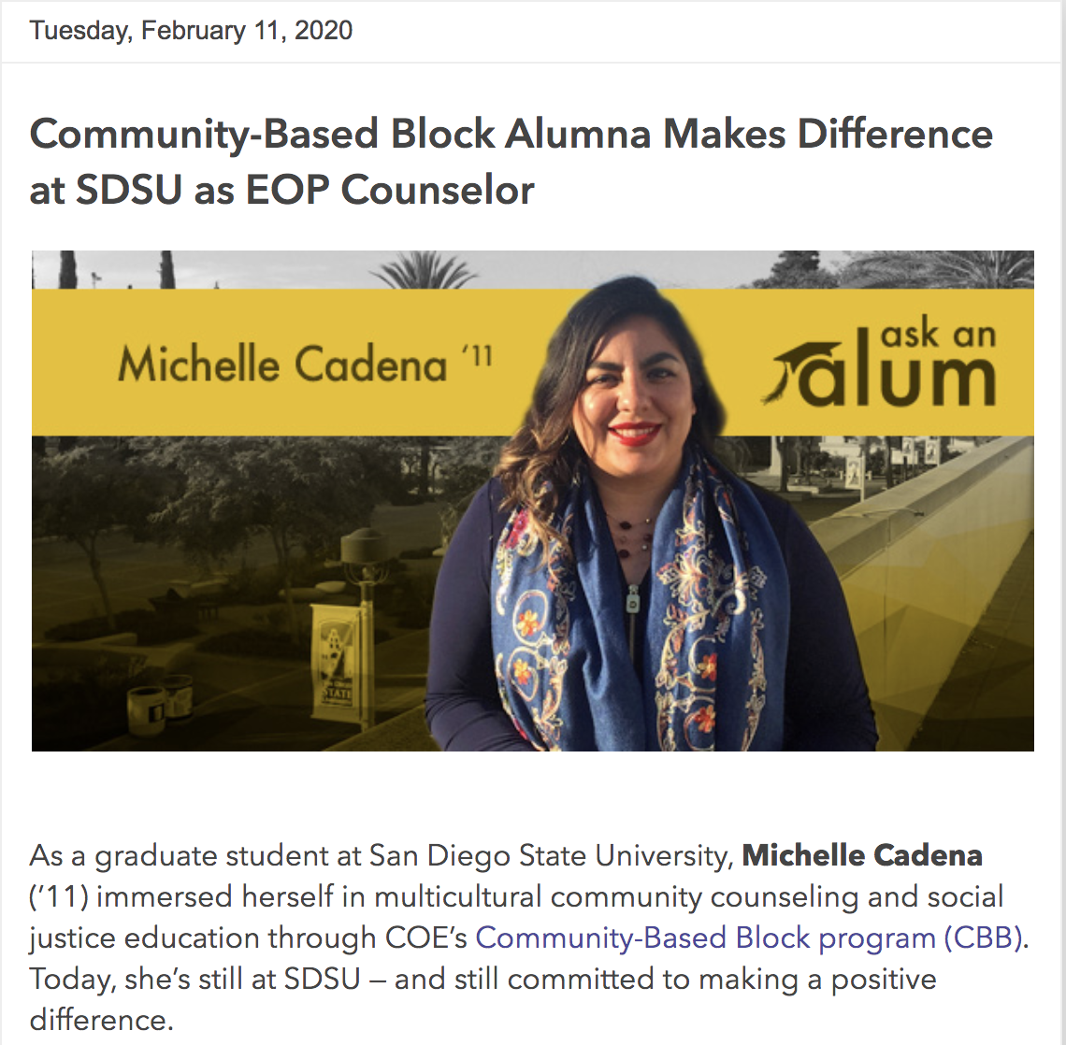
CBB Alumna
February 11, 2020
COE Informed & Inspired Newsletter

Slide 39
SDSU/Claremont Joint Doctoral Studies in Education & Counseling
CBB is currently piloting concurrent Joint Doctoral Program enrollment with CBB-LPCC Year #2
Dissertation Presentation:
At the Crossroads of Aspiration and Achievement Star Rivera-Lacey, CBB ‘96 Dissertation Presentation, Dean—SDCCD Adult Continuing Education
The study examines the educational and counseling experiences of low-income, first- generation, Latino/a, community college students. It specifically investigates the academic aspirations and achievements of these students, and the value they place on a community college education. The study also explores the influence community college counselors exert over student-stated academic aspirations and achievements. Finally, it explores the factors students, and counselors, identify as attributing to the academic success and failure of low-income, first- generation, Latino/a, community college students.
Notes:
Nola, Terry & Darielle?

Slide 40
CBB COMMUNITY SERVICE & RESEARCH PROJECTS
Notes:
Nola

Slide 41
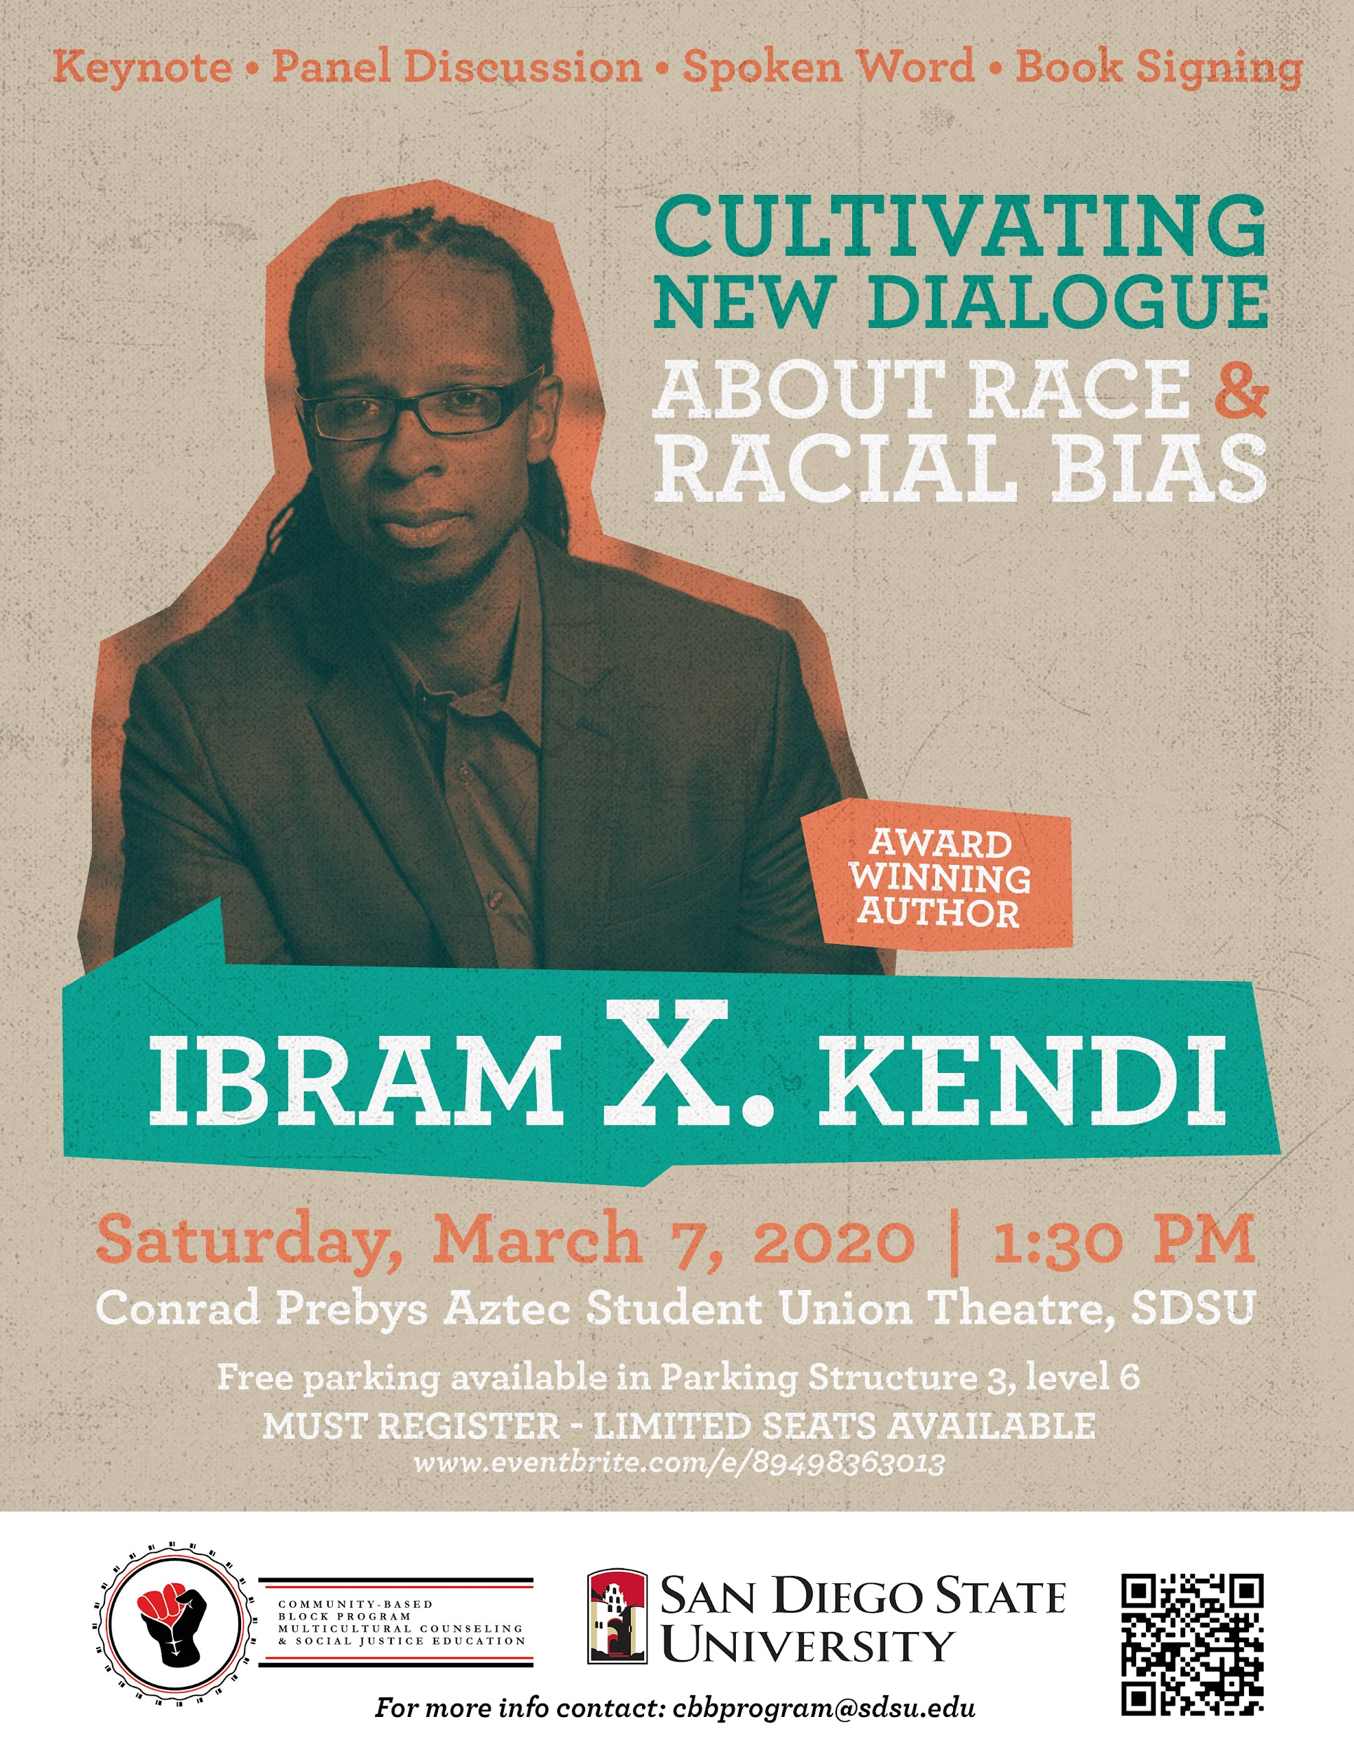
March 7, 2020
Keynote presentation
Panel Discussion
Book Signing
Community Healing & Info Circles

Slide 42
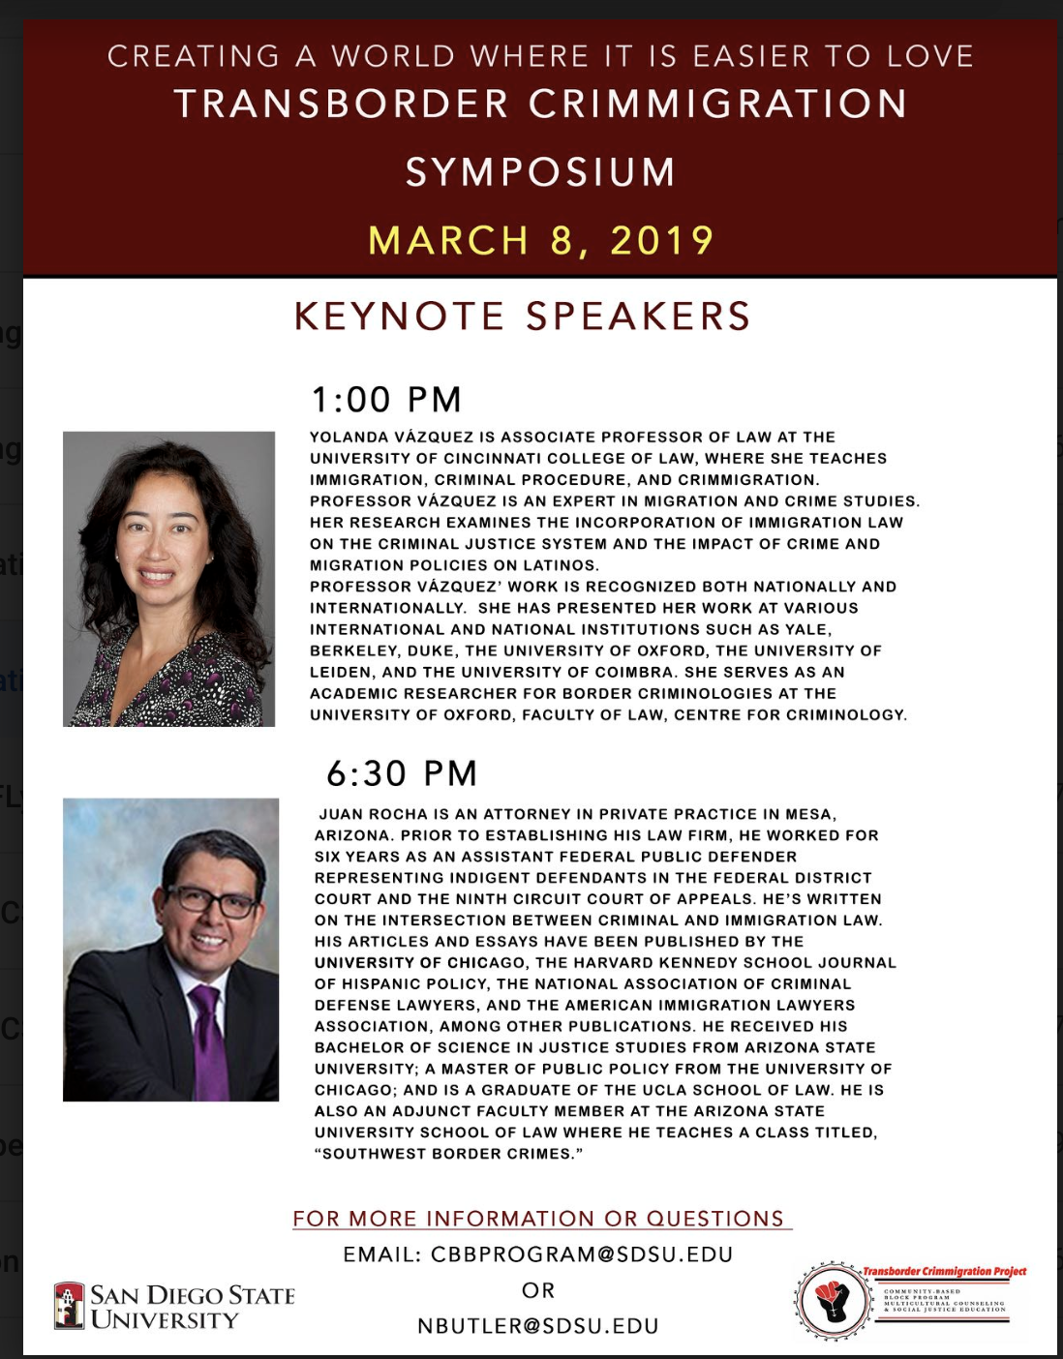
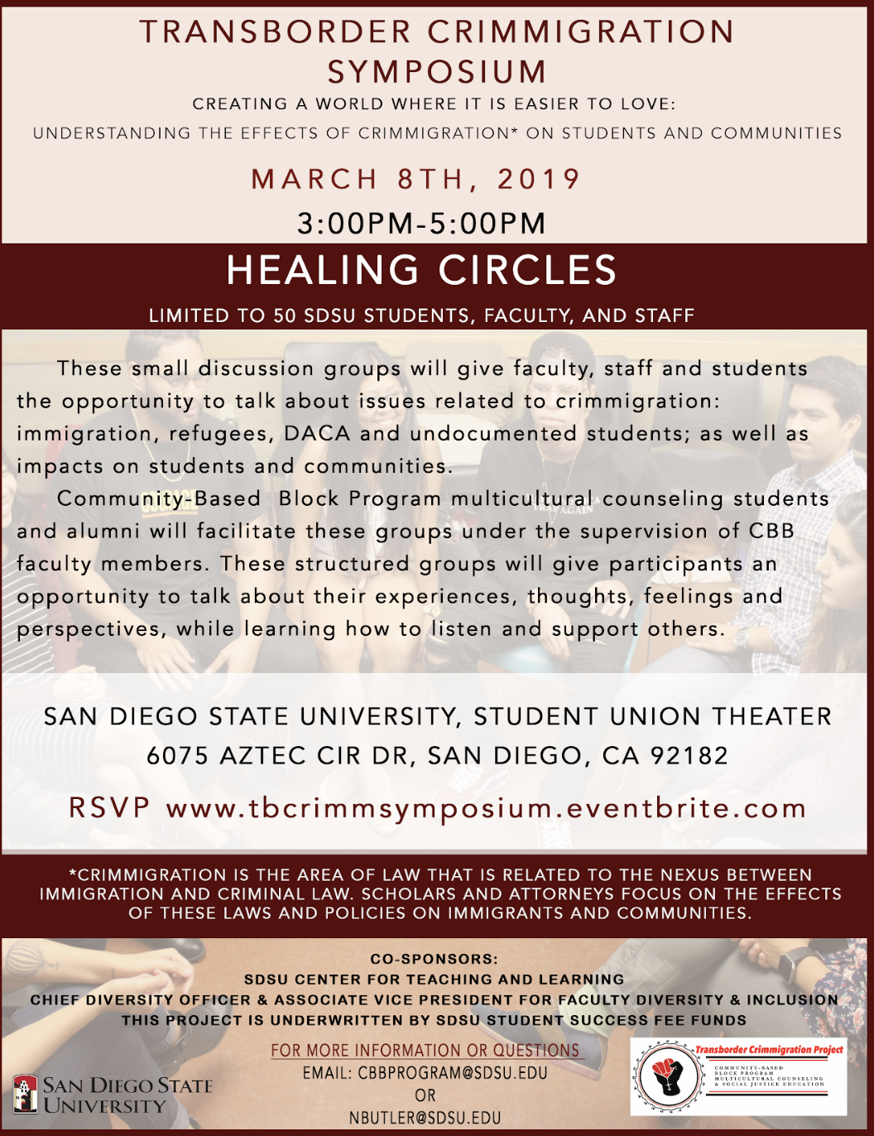
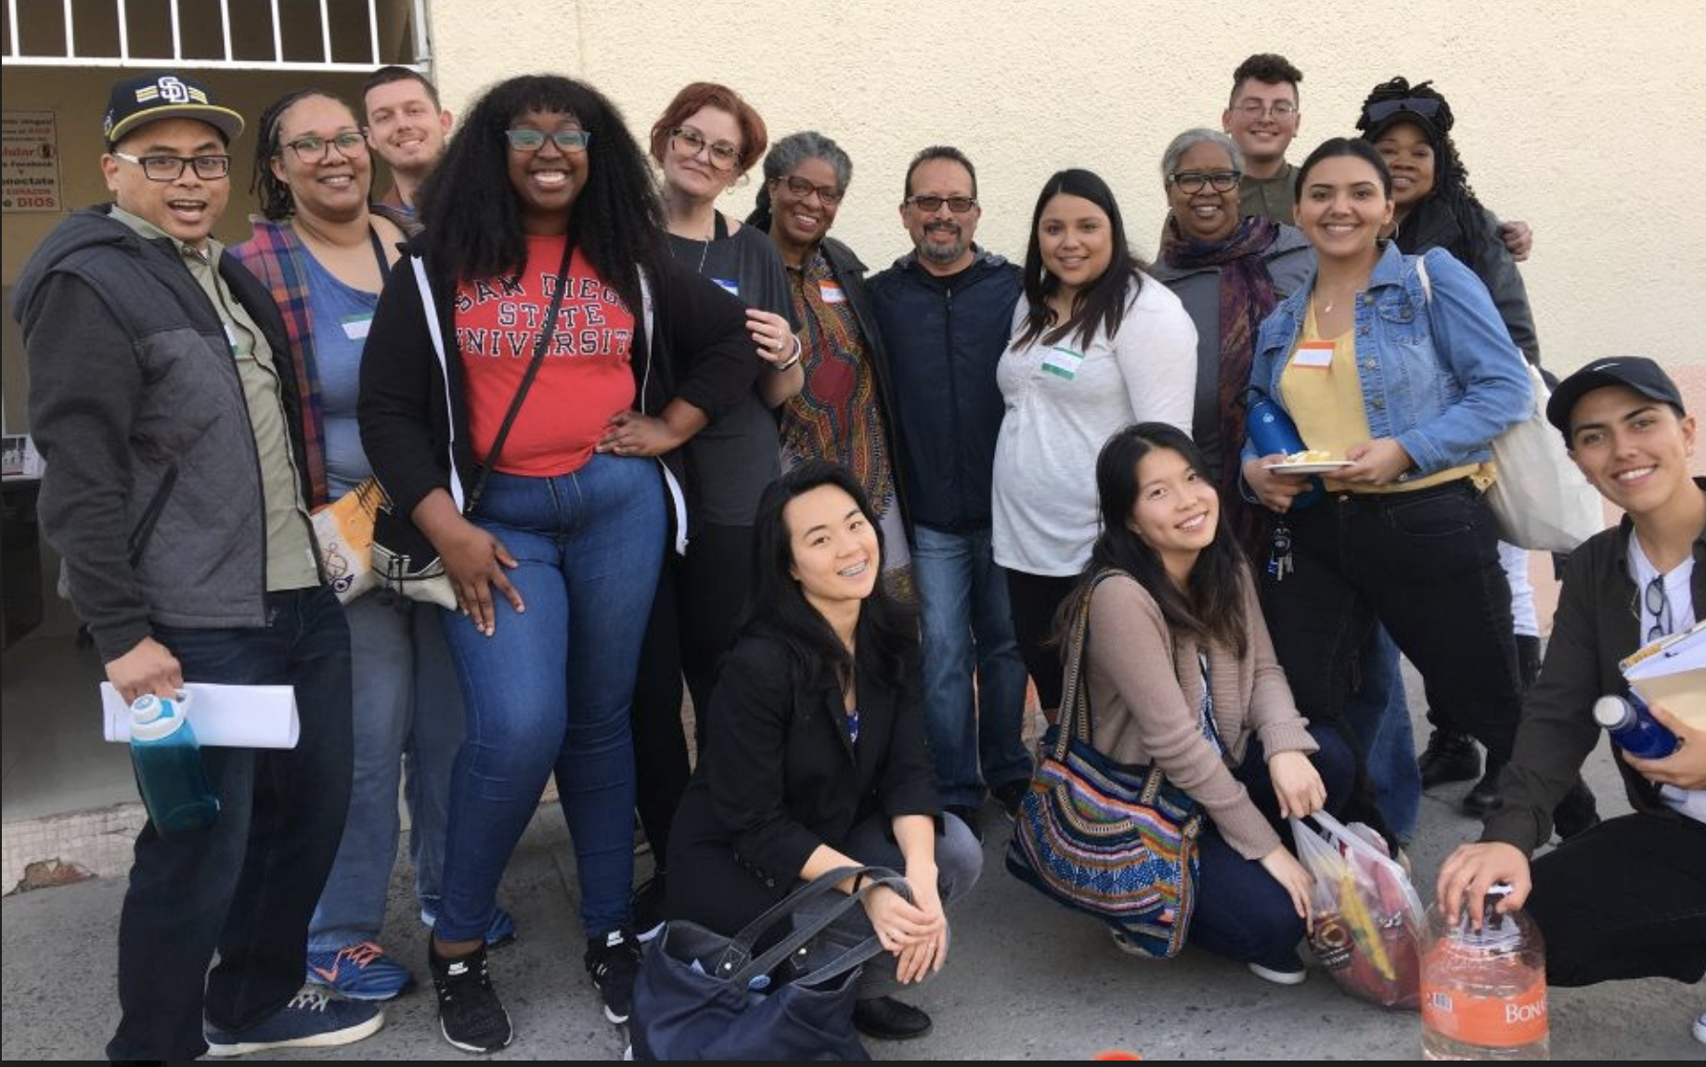
2018-20 CBB Transborder Crimmigration Project
Notes:
Mely & Lucio?

Slide 43
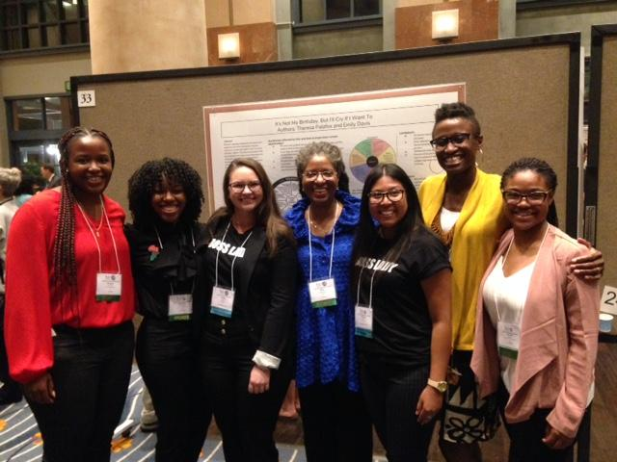
2016-18 Ubuntu Project
September 24, 2017--Institute on Violence, Abuse and Trauma (IVAT) Conference, San Diego, CA
Poster:
UBUNTU ANTI-RECIDIVISM PROJECT:
Building Peace and Forgiveness through Practice, Research and Advocacy
Winner National Partnership to End Interpersonal Violence Across the Lifespan Poster Award 2017
In photo from left to right:
Ahliyah Chambers (SDSU Undergrad), Jazzalyn Livingston (CBB’18), Emily Davis (CBB’18), Nola Butler Byrd (CBB Director), Theresa Palafox (CBB’18), Michelle Rowe-Odom (CBB Faculty Member), Darielle Blevins (CBB’13 & SDSU Joint Doc Program Student)
Notes:
Nola & Michelle?

Slide 44
Nola M. Butler Byrd, Michelle J. Rowe-Odom, Ojore L. Bushfan, Ava Gill, Kathleen Baca & Marva L. Lewis (2019) Using Hair-Combing Interactions to Enhance Relationships between Black Women and Girls Impacted by Homelessness, Women & Therapy, 42:3-4, 320-342, DOI: 10.1080/02703149.2019.1622912
Notes:
Nola & Michelle?

Slide 45
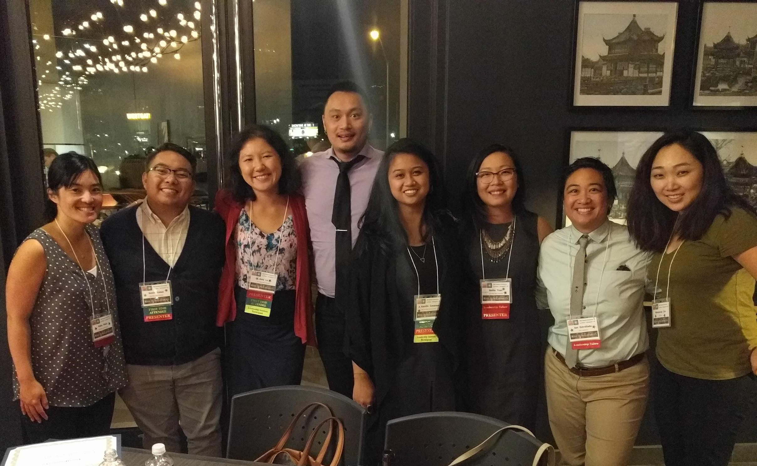
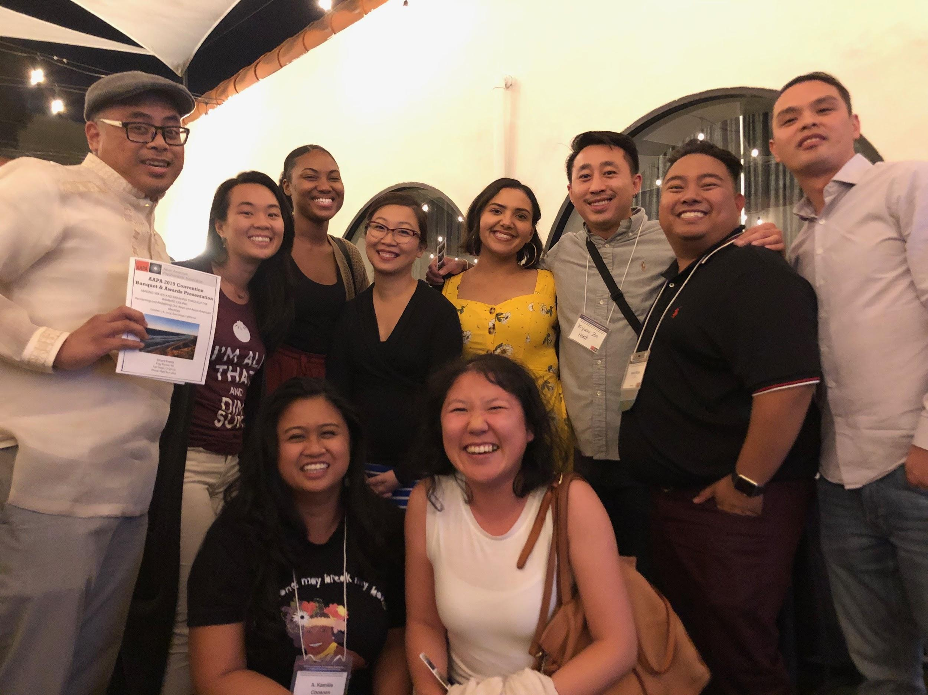
Asian American Psychological Association Conventions
Las Vegas, NV 2017
From left to right: Koko Nishi (SDSU Counseling & Psych Services), Kevin Yabas (CBB), Amy Lu (CBB), Kamille Conanan (CBB), Nellie Tran (CBB), Jan Estrellado (CBB alum), WonYoung Cho (MFT, Ed Doc, Undergrad Program, Online MA)
San Diego, CA 2019
From left to right: Marc Pescadara, Rosanna Thai, Kanisha Wilson, Nellie Tran, Lucy Plascencia, Kway Htet, Kevin Yabas, Tuan To, , Kamille Conanan, Amy Lu
Notes:
Nellie
October 6, 2017--Asian American Psychological Association’s convention in Las Vegas, NV
In photo from left to right: Koko Nishi (SDSU Counseling & Psych Services), Kevin Yabas (CBB), Amy Lu (CBB), Kamille Conanan (CBB), Nellie Tran (CBB), Jan Estrellado (CBB alum), WonYoung Cho (MFT, Ed Doc, Undergrad Program, Online MA)
CSP Faculty Meeting:
Nola will intro herself, then defer to Juan, Arianne and Nellie to intro themselves.
Open House:
Nola will introduce herself and provide a short welcome message and overview of the Info session, and intro the following, if they come:
-Dean Joe Johnson
-CSP Chair Brent Taylor
-Faculty will introduce themselves
-Students
-Interested applicants

Slide 46
CBB CLASSES MEET ON:
Mondays: 11am – 9pm
Tuesdays: 4 – 6:40pm
Wednesdays: 9am – 6pm
Plus, a minimum of 10 hours each week at community-based field sites
Notes:
Arianne
MONDAYS:
Location:
Center for Community Counseling and Engagement | Literacy Center
The Dede Albert Center for Community Engagement
San Diego State University Center for Community Counseling Suite #215 or Conference Room #240
4283 El Cajon Boulevard San Diego, CA 92105 (619) 594-4918
Each Monday the large group will meet in the mornings beginning around 11:00, followed by a lunch. Practica will meet at 2:30 or 3:00 p.m. We will have 3 practica (the lab in which you will work with clients). It will be mostly through practicum that we expect you to develop an ability to express a coherent counseling theory, to counsel effectively with clients and to conduct yourself in an ethical, professional manner.
TUESDAYS
Location: SDSU TBD
Possible Courses:
CSP 690 Methods of Investigation and Inquiry
CSP 642/L Assessment
CSP 693 Psychopharmacology
WEDNESDAYS
Location:
Beckwourth Public Library
721 San Pasqual St.
San Diego, CA
(619) 527-3040
(Located in Southeast San Diego behind the Educational Cultural Complex )

Slide 47
ADMISSIONS INFORMATION
Center for Community Counseling & Engagement
CBB Fall 2015
Notes:
Nola & Terry

Slide 48
CBB’s Holistic Admissions Processes
December 15th Priority application Due date
Late applicants will only be reviewed if space is available.
CBB’s admissions pool is competitive—typically 80-120 applicants for only 24-30 openings.
Many applicants have to apply more than once to get admitted.
We value authenticity, openness and honesty. Share your interpersonal challenges, as well as your strengths in your personal statement.
Notes:
Nola
CBB uses holistic admissions processes that looks at the applicant’s entire application portfolio. Our selection criteria are broad-based and clearly linked to the our mission and goals, and promote diversity as an essential element to achieving program excellence.
We look at a balance of applicant experiences, attributes, and academic metrics (E-A-M):
Is used to assess applicants with the intent of creating a richly diverse interview and selection pool and student body;
Is applied equitably across the entire candidate pool
Is grounded in data that provide evidence supporting the use of selection criteria beyond grades and test scores.
Admissions staff and committee members give individualized consideration to how each applicant may contribute to the CBB learning environment and to the profession, weighing and balancing the range of criteria needed in a class to achieve the outcomes desired by the school.
Universities often implement holistic review with the intent of increasing the diversity of their student bodies and developing a campus culture that values diversity and inclusion. The need for diversity is particularly important in the health professions, where lack of diversity among professionals may contribute to disparities in access to health care and services for minority populations. Access to care is often limited in areas heavily populated by ethnic minorities and immigrant communities (Smedley, Stith, and Nelson, 2003). Minority providers currently care for the bulk of minority patients in the United States and play a larger role than non-minority providers in treating patients in poor health (Edwards, Maldonado, & Engelgau, 2000; Terrell & Beaudreau, 2003; Komaromy et al., 1996; Marrast, Zallman, Woolhandler, Bor, and McCormick, 2013). Language and cultural barriers limit providers’ ability to serve the needs of minority patients in ways that are linguistically and culturally relevant (Kirch, 2012; Manetta et al., 2007). Having medical providers similar to patients in important dimensions of identity (e.g. race, ethnicity, language) enables effective communication and improves the provider- patient relationship (Ferguson & Canbib, 2002).
Holistic_Admissions_in_the_Health_Professions.pdf

Slide 49
Applicant Characteristics
The CBB program seeks applicants with:
Demonstrated interest in serving communities that tend to be underserved by the education and mental health professions.
Ability and willingness to take responsibility for their own learning.
Commitment to work on their own personal issues that could interfere in their work with clients, both in the program and outside the program by seeking counseling from a trained therapist.
Availability and willingness to commit to the weekly time requirements of the program: over 20 hours in the classroom, a minimum of 10 hours of fieldwork and sufficient time to study and engage in academic projects.
Notes:
Nola

Slide 50
Applicant Characteristics
Interest in taking classes off-campus in ethnically diverse neighborhoods.
Interest in becoming a change agent.
Commitment to participating in a learning community in which many decisions are made by consensus, which can ^{be frustrating.}
Oral and written communication skills at a graduate level. • Interest in working with real clients who may have serious ^{personal issues.}
Willingness to contribute to the learning of others.
Notes:
Nola

Slide 51
Advice for Applicants
Work on yourself—go to therapy.
Be authentic—we want to know who you really are.
Share your interpersonal challenges, as well as your strengths.
Get letters of recommendation from people who really know you and are authentic.
If you are dealing with significant challenges, this may not be a good time for you to matriculate in CBB.
Legal issues, including DUI’s – can prevent licensure.
Notes:
Arianne - CBB Faculty

Slide 52
Financial Advice for Applicants
CBB is a full-time commitment, so it is extremely difficult to work an outside job and do well in the program.
Some CBB field sites pay; but many really good sites don’t.
If you need financial aid, Remember to submit your FAFSA form between Jan. 1 and March 2. Please contact the SDSU Financial Aid Office for information about financial aid and scholarships.
If you are an out-of-state or international applicant, request CA residency requirements ASAP, so you can qualify for in-state tuition as soon as you possibly can.
Notes:
Arianne CBB Faculty

Slide 53
CBB Upcoming Due Dates & Events for Applicants
Application Due Dates
Interview Day
Priority Due Date*: December 15, 2021
Supplemental Materials Due Date: January 12, 2022
*Late applications will only be reviewed if space is available.
TBD
Notes:
Nola & Terry

Slide 54
For More Information Contact:
Program Director
CBB Graduate Assistant
Nola Butler Byrd, Ph.D., LPCC
nbutler@sdsu.edu
619-594-3128
Terry Sivers, MS, Doctoral Student
cbbgradasst@sdsu.edu
619-594-3128
Admissions Coordinator
For questions w/ online application submission
Melanie Falkenberg
mfalkenb@sdsu.edu
619-594-6117

Slide 55
Notes:
CBB4Life Alumni Association

